Slide 1
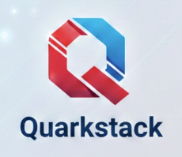
QuarcksTACK OVERVIEW

Slide 2
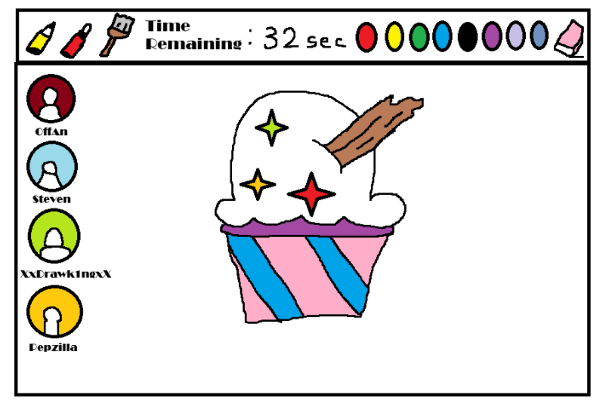
WHY ARE WE HERE
We’re launching an online multiplayer drawing game where players compete in creative challenges generated by AI, which also grades their artwork in real time.

Slide 3
Elevator pitch
1. Hook / Problem: "Ever wanted a fast, fun way to test your drawing skills against friends—and strangers—online?"
2. Solution / Product: "QuarkSketch is an online drawing showdown where players race to interpret creative prompts and outdraw their opponents.“
3. Differentiator / Why it’s special: "AI generates fresh challenges, helps score each round, and players vote to crown the winner, making every match unpredictable, social, and competitive.“
4. Call to Action / Vision: "Join the community and see if your drawings can beat the rest—where creativity meets competition in real time."

Slide 4
Design a product box
QuarckSketch
Draw it. Guess it. Watch it go wrong.
TOP 3 REASONS YOU’LL LOVE IT
Instant Fun With Friends Jump in and start playing immediately — no complicated setup.
Creativity Without Pressure You don’t need to be an artist. The worse the drawing, the funnier it gets.
Perfect for Any Group Great for parties, classrooms, team-building, or online hangouts.

Slide 5
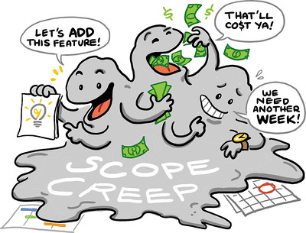
IN scope/not list
In Scope:
Development of Android application
Responsive and readable UI design
Implementation of core app features (drawing tools, game settings)
Frequent testing and bug fixing
Out of Scope:
Development of new features after launch
Marketing activities
Standalone PC client application

Slide 6
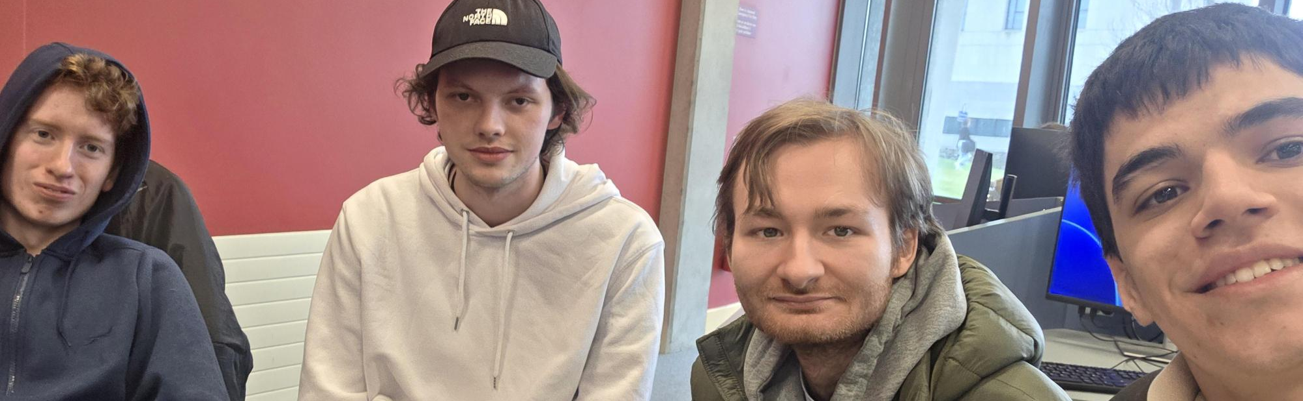
Meet the neighbours
Marko Radojcic – QA Tester
Niall Concannon – Project Owner
Daniel Balcerzak – Scrum Master
Kamil Ciemniejewski – Dev Ops
External Stakeholders – Users

Slide 7
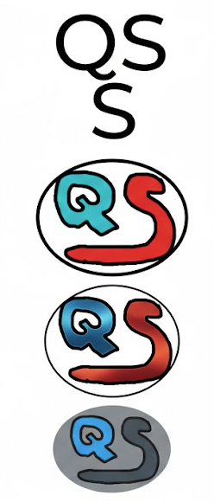
Architecture overview
Frontend
Built with Angular (TypeScript)
Provides the drawing canvas and guessing interface
Sends and receives data from the backend using HTTP requests
Backend
Built with Node.js and TypeScript
Handles game logic (rounds, prompts, scoring)
Manages players and game sessions
Communicates with the database
Database
MySQL database
Stores:
Users
Game rooms
Prompts
Scores
Game history

Slide 8
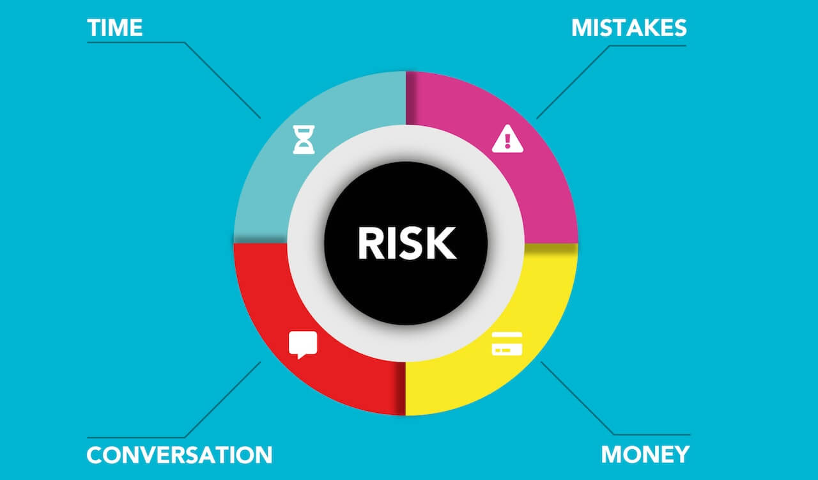
What keeps us up at night?
Key Project Risks
Scope creep: too many features, tight deadlines
Drawing canvas: bugs or performance issues
Team workload: uneven distribution
Time estimation: underestimating feature implementation

Slide 9
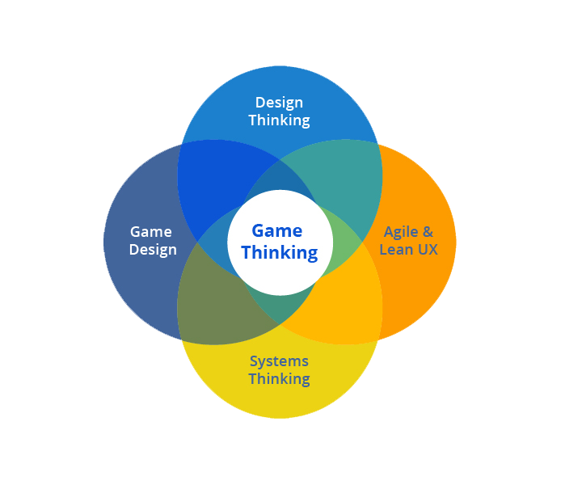
Size it up!
Project Timeline & Approach
Estimated Duration ~8 weeks
Core functionality delivered first to establish a stable foundation
Additional features developed in short, iterative Scrum sprints
Ongoing testing and improvements throughout development

Slide 10
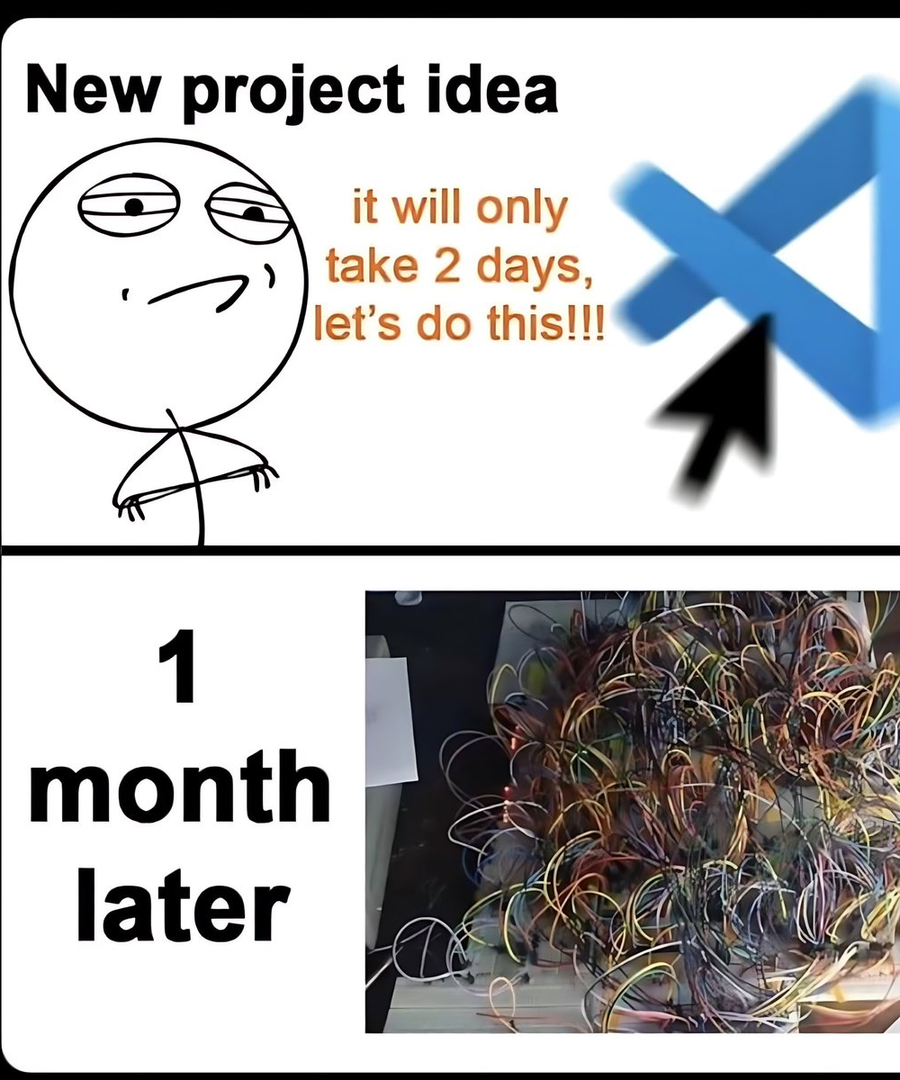
Potential Scope Adjustments
To ensure smooth multiplayer gameplay and reliable AI grading, some non-essential features may be limited:
Extra drawing tools may be removed to improve performance and reduce lag
User accounts or score history may be simplified to speed development
UI elements may be streamlined for clarity during fast-paced rounds
Core focus Maintain a stable drawing canvas, AI-powered grading, prompts, timer, and voting system

Slide 11
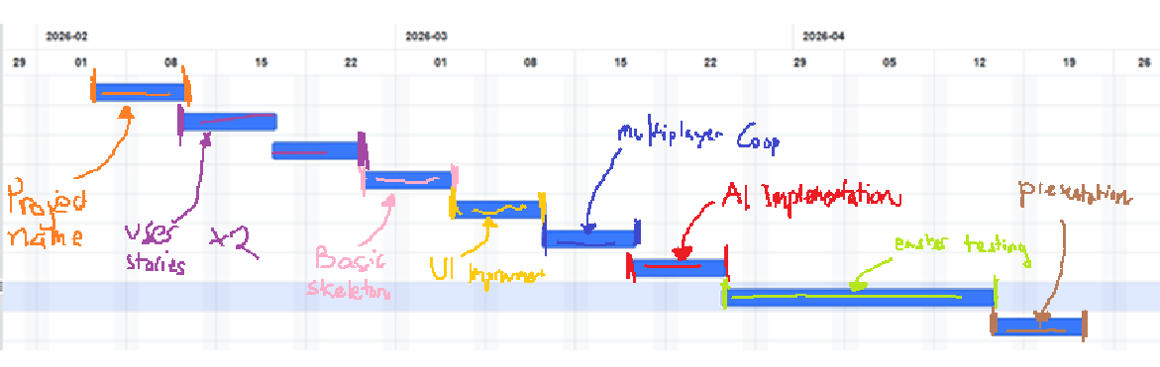
Whats it going to take?
Time
12/02: Idea chosen
19/02: Requirements ready
26/02–05/03: Core drawing + UI
12/03–19/03: AI game + multiplayer
26/03–16/04: Integration & testing
23/04: Present
Cost
Minimal (student project: dev time + free/open-source tools)
Resources
4 people: frontend, backend, AI, UI/UX & testing

Slide 12
Thanks for listening

